Slide 1

Comp 401 Model-View-Controller (MVC)
Instructor: Prasun Dewan

Slide 2
Prerequisites
Interfaces
Main Console Input
Inheritance

Slide 3
General Problem
How to break up our program into multiple classes?

Slide 4
Separation of Concerns
History Semantics
History Semantics
History Display 1
History Display 2
Can change display without changing other aspects of history
Display and semantics should go in different classes

Slide 5
Separation of Concerns
A
A
B
B’
if a part A of a class can be changed without changing some other part B of the class, then refactor and put A and B in different classes

Slide 6
Patterns
Recurring theme
Bean, Vector pattern
Conventions for readability
Loop patterns
Event-controlled
Counter controlled
Design patterns
Helps identify the kind of classes our program should have

Slide 7
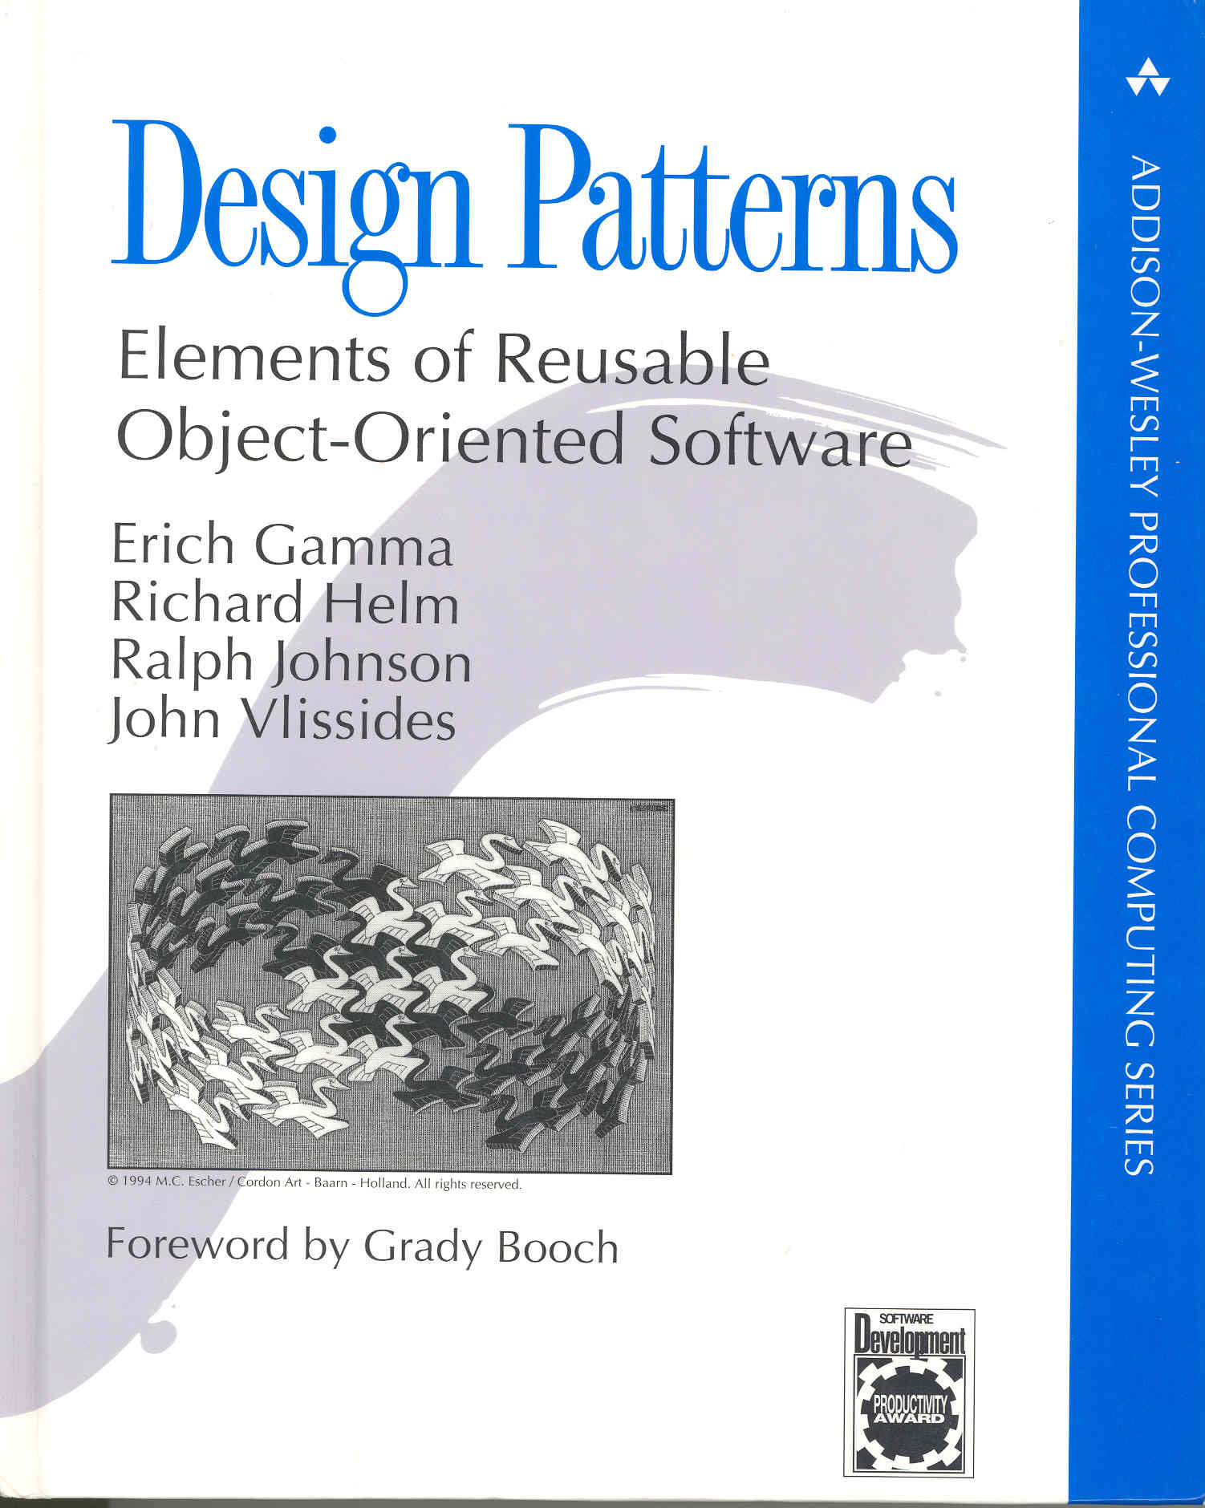
Design Pattern
Reusable program decomposition pattern
Not specific class or interface, infinite family of classes/interfaces implement this pattern.
Usually involves multiple objects
Language-independent
Include architecture and frameworks
Inspired by Architectural Pattern (Chrstopher Plummer)

Slide 8

SIMILAR
DIFFERENT
2nd story porch
supported by
1st floor porch
columns
No outside stairs to
2nd story
Flat (not bay) window
Wide plank siding
Screened-in porch

Slide 9
MVC Motivation
History Semantics
History Semantics
History Display 1
History Display 2
Can change display without changing other aspects of history
Display and semantics should go in different classes

Slide 10
MVC Motivation
Object Semantics/Service
Object Semantics/service
Object User Interface
Object User Interface

Slide 11
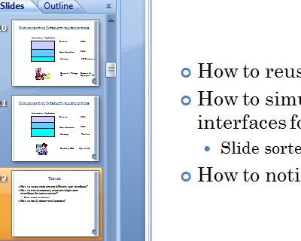
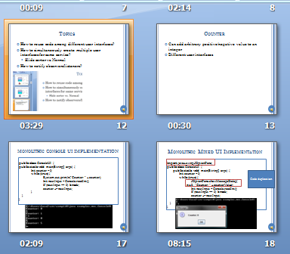
Questions
How to reuse code among different interactive applications offering the same service?
How to simultaneously create multiple user interfaces for same service?
Normal vs. Slide sorter
Shortcuts vs. menus vs. buttons

Slide 12
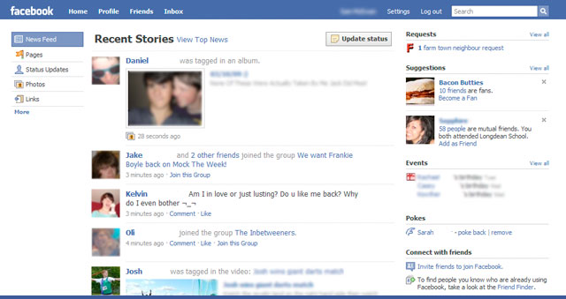

Questions
How to simultaneously create multiple user interfaces for same service on different computers?
Facebook, email

Slide 13
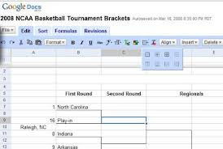

Questions
How to simultaneously create distributed user interfaces
multiple complete user interfaces for different users on different computers
Single user-interface on large computer controlled by multiple mobile devices

Slide 14

Example: Counter
Can add arbitrary positive/negative value to an integer
Different user interfaces

Slide 15
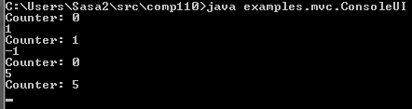
Console Input and Output

Slide 16
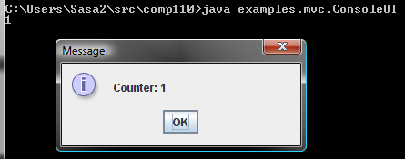
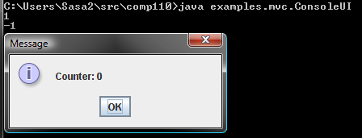
Console Input and JOption Output

Slide 17
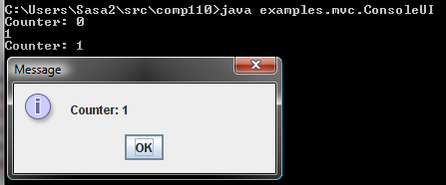
Console Input,Output and JOption Output

Slide 18
Monolithic Console UI IMPLEMENTATION
public class MonolithicConsoleUI {
public static void main(String[] args) {
int counter = 0;
while (true) {
System.out.println("Counter: " + counter);
int nextInput = Console.readInt();
if (nextInput == 0) break;
counter += nextInput;
}
}
}

Slide 19
Monolithic Console UI IMPLEMENTATION
public class MonolithicConsoleUI {
public static void main(String[] args) {
int counter = 0;
while (true) {
System.out.println("Counter: " + counter);
int nextInput = Console.readInt();
if (nextInput == 0) break;
counter += nextInput;
}
}
}

Slide 20
Monolithic Mixed UI Implementation
import javax.swing.JOptionPane;
public class ConsoleUI {
public static void main(String[] args) {
int counter = 0;
while (true) {
JOptionPane.showMessageDialog(
null, “Counter: ” + counter);
int nextInput = Console.readInt();
if (nextInput == 0) break;
counter += nextInput;
}
}
}
Code duplication

Slide 21
Multiple UIs?
import javax.swing.JOptionPane;
public class ConsoleUI {
public static void main(String[] args) {
int counter = 0;
while (true) {
JOptionPane.showMessageDialog(
null, “Counter: ” + counter);
int nextInput = Console.readInt();
if (nextInput == 0) break;
counter += nextInput;
}
}
}
Cannot use both UIs simultaneously to update same counter

Slide 22
Counter Model
public class ACounter implements Counter {
int counter = 0;
public void add (int amount) {
counter += amount;
}
public int getValue() {
return counter;
}
}
No input/output

Slide 23
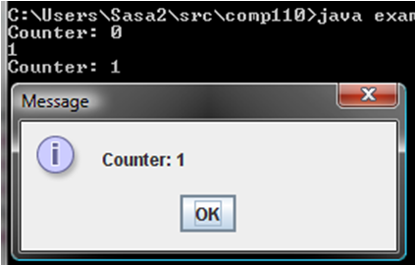
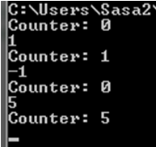
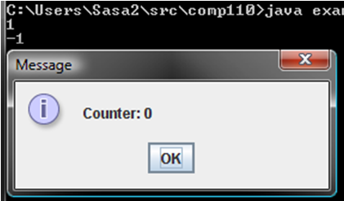
Model/Interactor(Editor) Separation
Interactor
Model
Interactor
AConsoleUI
Counter
AMultipleUI
AMixedUI
Interactor or Editor
Model has no UI code and only semantics!
public static void main (String args[]) {
(new AConsoleUI()).edit (new ACounter());
}

Slide 24
Model?

Slide 25
Counter Model
public class ACounter implements Counter {
int counter = 0;
public void add (int amount) {
counter += amount;
}
public int getValue() {
return counter;
}
}
No input/output

Slide 26
Monolithic Console UI IMPLEMENTATION
public class ConsoleUI {
public static void main(String[] args) {
int counter = 0;
while (true) {
System.out.println("Counter: " + counter);
int nextInput = Console.readInt();
if (nextInput == 0) break;
counter += nextInput;
}
}
}

Slide 27
Console Interactor
public class AConsoleUIInteractor implements CounterInteractor {
public void edit (Counter counter) {
while (true) {
System.out.println("Counter: " + counter.getValue());
int nextInput = Console.readInt();
if (nextInput == 0) return;
counter.add(nextInput);
}
}
}

Slide 28
Mixed Interactor
public class AMixedUIInteractor implements CounterInteractor {
public void edit (Counter counter) {
while (true) {
JOptionPane.showMessageDialog(null,
"Counter: " + counter.getValue());
int nextInput = Console.readInt();
if (nextInput == 0) break;
counter.add(nextInput);
}
}
}
Shared Model Code
Output
Input
I/O Code is Duplicated
UI Implementation is now monolithic

Slide 29
Multiple UI Interactor
public class AMultipleUI implements CounterInteractor {
public void edit (Counter counter) {
while (true) {
System.out.println("Counter: " + counter.getValue());
JOptionPane.showMessageDialog(null,
"Counter: " + counter.getValue());
int nextInput = Console.readInt();
if (nextInput == 0) break;
counter.add(nextInput);
}
}
}
Shared Model Code
Output
Input
I/O Code is Duplicated
UI Implementation is now monolithic

Slide 30
Drawbacks of Monolithic UI
AConsoleUI
Duplicated Input Code
Counter
AMixedUI
Duplicated Output Code
AMultipleUI

Slide 31
Model/Interactor Pattern
Interactor
UI Code
Arbitrary UI unaware methods
Model
Computation Code

Slide 32
MVC Pattern
Controller
View
Performs Input
Performs Output
Model
Write Methods
Read Methods
View can be on computer with big screen and controller on smart phone

Slide 33
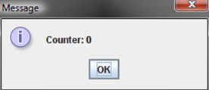

MVC Pattern in Counter
Controller
View
Performs Input
Performs Output
Model
add()
getValue()

Slide 34
Changing to Console View
Controller
View
Performs Input
Performs Output
Model
add()
getValue()

Slide 35
Multiple Views
Controller
View
Performs Input
Performs Output
Model
add()
getValue()
View

Slide 36
Multiple Views and Controllers
Controller 1
View 1
Controller 2
Model
View 2
Controller 3
View 3
Menus, buttons, shortcuts can be handled by different controllers (in same or different program)
Controller 4
View 4

Slide 37
Syncing Controllers & View
Controller 1
View 1
Controller 2
Model
View 2
Controller 3
View 3
Controller 4
View 4
In Http-based “MVC” a single view and controller exist in the browser and the model in the server. A Model cannot initiate actions in the browser so the controller directly communicates with the view

Slide 38
Observer Pattern
Observable
Observers
View 1
Model
View 2
Changed model notifies views
View 3
View 4

Slide 39
Multiple Observers/Observables
A single battle simulation view observing
Multiple planes
Multiple tanks
Observer 1
How does observable know about its observers?
Observable 1
Observer 2
Observable 2
Observer 3
Observer registered with observable
Observer N

Slide 40
Notification Scheme
Each observer is registered with observable
Each write method in observable calls a notification method in each observer
Observer 1
Notification method in observer reads model
Observable 1
Observer 2
Observable 2
Observer 3
Each student is registered with professor’s listserv
When web page is updated mail sent to students
Observer N
Student reads web page if mailed information is not sufficient

Slide 41
MVC Pattern (Review)
Controller
View
Performs Input
Performs Output
Model
Write Methods
Read Methods
View can be on computer with big screen and controller on smart phone

Slide 42
MVC Pattern in Counter (Review)
Controller
View
Performs Input
Performs Output
Model
add()
getValue()

Slide 43
Observer Pattern
Observable
Observers
Controller 1
View 1
Controller 2
Model
View 2
Changed model notifies views
Controller 3
View 3
Controller 4
View 4

Slide 44
Notification Scheme (Review)
Each observer is registered with observable
Each write method in observable calls a notification method in each observer
Observer 1
Notification method in observer reads model
Observable 1
Observer 2
Observable 2
Observer 3
Each student is registered with professor’s listserv
When web page is updated mail sent to students
Observer N
Student reads web page if mailed information is not sufficient

Slide 45
General Notification Scheme
Observers may have multiple observables with common notification method
Observer 1
Notification method parameter indicates which observable
Observable 1
Observer 2
Observable 2
Observer 3
Observer N

Slide 46
Notifications in MVC Pattern
Controller
Notification Method
View
Performs Input
Performs Output
Model
Write Methods
Read Methods
Observer Registration Method

Slide 47
Implementation dependent issues
How does controller know about model?
Model connection method invoked on it
By model or some other program
Main
Who registers observer registered with observable?
It registers itself if it knows about observable
Model registers it if it knows about observer
Some other code registers it
Main

Slide 48
Complete MVC
Model Connection Method
Controller
Notification Method
View
Performs Input
Performs Output
Model
Write Methods
Read Methods
Observer Registration Method

Slide 49
Observable and Observer
Each observer is registered with observable
Each write method in observable calls a notification method in each observer
Notification method in observer reads model

Slide 50
Counter Observable and Observer
Console View, JOption View
public interface ObservableCounter {
public void add (int amount) ;
public int getValue() ;
public void addObserver(CounterObserver observer);
public void removeObserver(CounterObserver observer);
}
public interface CounterObserver {
public void update(ObservableCounter counter);
}
Called whenever model is updated
Updated model

Slide 51
Counter Model
public class AnObservableCounter implements ObservableCounter {
int counter = 0;
ObserverList observers = new AnObserverList();
public void add (int amount) {
counter += amount;
notifyAllObservers();
}
public int getValue() {
return counter;
}
public void addObserver(CounterObserver observer) {
observers.addElement(observer);
observer.update(this);
}
public void removeObserver(CounterObserver observer) {
observers.removeElement(observer);
}
void notifyAllObservers() {
for (int observerNum = 0; observerNum < observers.size();
observerNum++)
observers.elementAt(observerNum).update(this);
}
}
Give this observable initial value
Each write method notifies all!

Slide 52
Console View
public class ACounterConsoleView implements CounterObserver {
public void update(ObservableCounter counter) {
System.out.println("Counter: " + counter.getValue());
}
}

Slide 53
JOption View
import javax.swing.JOptionPane;
public class ACounterJOptionView implements CounterObserver {
public void update(ObservableCounter counter) {
JOptionPane.showMessageDialog(
null, "Counter: " + counter.getValue());
}
}

Slide 54
Console Controller Interface
public interface CounterController {
public void setModel(ObservableCounter theCounter);
public void processInput();
}

Slide 55
Console Controller
public class ACounterController implements CounterController {
ObservableCounter counter;
public void setModel(ObservableCounter theCounter) {
counter = theCounter;
}
public void processInput() {
while (true) {
int nextInput = Console.readInt();
if (nextInput == 0) break;
counter.add(nextInput);
}
}
}

Slide 56
Console Main
public static void main (String args[]) {
ObservableCounter model = new AnObservableCounter();
model.addObserver(new ACounterConsoleView());
CounterController controller = new ACounterController();
controller.setModel(model);
controller.processInput();
}

Slide 57
Console and JOption Main
public static void main (String args[]) {
ObservableCounter model = new AnObservableCounter();
model.addObserver (new ACounterJOptionView());
CounterController controller = new ACounterController();
controller.setModel(model);
controller.processInput();
}
Shared input code

Slide 58
Mixed UI Main
public static void main (String args[]) {
ObservableCounter model = new AnObservableCounter();
model.addObserver(new ACounterJOptionView());
model.addObserver (new ACounterConsoleView());
CounterController controller = new ACounterController();
controller.setModel(model);
controller.processInput();
}

Slide 59
Efficiency
public interface CounterObserver {
public void update(ObservableCounter counter);
}
public class ACounterConsoleView implements CounterObserver {
public void update(ObservableCounter counter) {
System.out.println("Counter: " + counter.getValue());
}
}
What if observer is in USA and observable in China?
Update must make a “long distance” call to read method (getValue()) to update counter state

Slide 60
Notification with Change Description
No need to call read method after notification
public interface CounterObserver {
public void update(ObservableCounter counter, int newCounterVal);
}
public class ACounterConsoleView implements CounterObserver {
public void update(ObservableCounter counter, int newCounterVal) {
System.out.println("Counter: " + newCounterVal));
}
}

Slide 61
ObjectEditor Update?
public interface CounterObserver {
public void update(ObservableCounter counter, int newCounterVal);
}
Can ObjectEditor become a view of Counter so no need to call refresh?
ObjectEditor does not know about CounterObserver and cannot implement it.

Slide 62
java.util.Observer and Observable
“Standard” observer interface talking arbitrary change Object argument
public interface java.util.Observer {
public void update(Observable o, Object arg);
}
public class java.util.Observable {
public void addObserver(Observer o) { … };
public void notifyObservers() { … };
}
Model must be subclass of Observable

Slide 63
Extra

Slide 64

Circularity
public interface ObservableCounter {
public void add (int amount) ;
public int getValue() ;
public void addObserver(CounterObserver observer);
public void removeObserver(CounterObserver observer);
}
Cannot compile ObservableCounter without CounterObserver and vice versa
public interface CounterObserver {
public void update(ObservableCounter counter);
}

Slide 65
Breaking Circularity: Multiple Stages
public interface ObservableCounter {
public void add (int amount) ;
public int getValue() ;
}
CounterObserver references compiled ObservableCounter
public interface CounterObserver {
public void update(ObservableCounter counter);
}

Slide 66
Circularity
public interface ObservableCounter {
public void add (int amount) ;
public int getValue() ;
public void addObserver(CounterObserver observer);
public void removeObserver(CounterObserver observer);
}
Recompiled observable references compiled CounterObserver
public interface CounterObserver {
public void update(ObservableCounter counter);
}

Slide 67
Circularity and Breaking it
Circularity
Two types reference each other
Neither can be compiled without the other
General approach to breaking it
Create both types as empty and compile them so they are known to Java
Next add references to each other

Slide 68
Counter Model
public class AnObservableCounter implements ObservableCounter {
int counter = 0;
ObserverList observers = new AnObserverList();
public void add (int amount) {
counter += amount;
notifyAllObservers();
}
public int getValue() {
return counter;
}
public void addObserver(CounterObserver observer) {
observers.addElement(observer);
observer.update(this);
}
public void removeObserver(CounterObserver observer) {
observers.removeElement(observer);
}
void notifyAllObservers() {
for (int observerNum = 0; observerNum < observers.size();
observerNum++)
observers.elementAt(observerNum).update(this);
}
}
Give this observable initial value
Each write method notifies all!

Slide 69
Console View
public class ACounterConsoleView implements CounterObserver {
public void update(ObservableCounter counter) {
System.out.println("Counter: " + counter.getValue());
}
}

Slide 70
JOption View
import javax.swing.JOptionPane;
public class ACounterJOptionView implements CounterObserver {
public void update(ObservableCounter counter) {
JOptionPane.showMessageDialog(
null, "Counter: " + counter.getValue());
}
}

Slide 71
Console Controller Interface
public interface CounterController {
public void setModel(ObservableCounter theCounter);
public void processInput();
}

Slide 72
Console Controller
public class ACounterController implements CounterController {
ObservableCounter counter;
public void setModel(ObservableCounter theCounter) {
counter = theCounter;
}
public void processInput() {
while (true) {
int nextInput = Console.readInt();
if (nextInput == 0) break;
counter.add(nextInput);
}
}
}

Slide 73
Console Main
public static void main (String args[]) {
ObservableCounter model = new AnObservableCounter();
model.addObserver(new ACounterConsoleView());
CounterController controller = new ACounterController();
controller.setModel(model);
controller.processInput();
}

Slide 74
Console and JOption Main
public static void main (String args[]) {
ObservableCounter model = new AnObservableCounter();
model.addObserver (new ACounterJOptionView());
CounterController controller = new ACounterController();
controller.setModel(model);
controller.processInput();
}
Shared input code

Slide 75
Mixed UI Main
public static void main (String args[]) {
ObservableCounter model = new AnObservableCounter();
model.addObserver(new ACounterJOptionView());
model.addObserver (new ACounterConsoleView());
CounterController controller = new ACounterController();
controller.setModel(model);
controller.processInput();
}

Slide 76
Observers that are not views
Spreadsheet cell
observes cells on which it depends
Monitoring of appliance usage
Each time I do setChannel() on TV event logged
Eclipse quiz/activity plug-in
Observers Eclipse events
Any big brother app!
Counter observer?

Slide 77

Observers that are not views
Spreadsheet cell
observes cells on which it depends
Monitoring of appliance usage
Each time I do setChannel() on TV event logged
Eclipse quiz/activity plug-in
Observers Eclipse events
Any big brother app!
Counter observer?

Slide 78
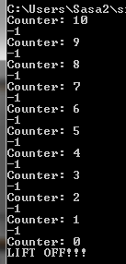

Rocket Observer
public class ARocketLaunchingCounterObserver
implements CounterObserver {
public void update(ObservableCounter counter) {
if (counter.getValue() == 0)
launch();
}
private void launch() {
System.out.println("LIFT OFF!!!");
}
}

Slide 79
Instances created and composed
Console View added before rocket launching observer
AnObservable
Counter
ACounterConsoleView
Controller
ARocketLaunchingCounterObserver
ARocketLauncher

Slide 80
Rocket Launching Main
public static void main (String args[]) {
ObservableCounter model = new AnObservableCounter();
model.addObserver (new ACounterConsoleView());
model.addObserver(new ARocketLaunchingCounterObserver());
CounterController controller = new ACounterController();
controller.setModel(model);
controller.processInput();
}

Slide 81
Basic Notification
public interface CounterObserver {
public void update(ObservableCounter counter);
}
Called when observer is updated
Updated Observable

Slide 82
Implicit Observer
Updated Observable
public interface CounterObserver {
public void setObservable(ObservableCounter counter);
public void update();
}
Assuming observer has only one observable

Slide 83
Distribution Issues
public interface CounterObserver {
public void update(ObservableCounter counter);
}
What if observer is in USA and observable in China?
Update must make a “long distance” call to read method (getValue()) to update counter state

Slide 84
Notification with Change Description
No need to call read method after notification
package models;
public interface CounterObserver {
public void update(ObservableCounter counter, int newCounterVal);
}

Slide 85
Java java.util.Observer
public interface java.util.Observer {
public void update(Observable o, Object arg);
}
“Standard” observer interface talking arbitrary change Object argument

Slide 86
Notification with Changed Value
New value of observable attribute
public interface CounterObserver {
public void update(ObservableCounter counter, int newCounterVal);
}

Slide 87
Notification with Change
Difference between new and old value of observable attribute
public interface CounterObserver {
public void update(ObservableCounter counter, int counterIncrement);
}
Observer may display change to user
Observer interested in change does not need to keep old value to determine change
Observer interested in absolute value must keep old value

Slide 88
Notification with New and Old Value
Old and new value of observable attribute
public interface CounterObserver {
public void update (ObservableCounter counter,
int oldCounterValue, int newCounterValue);
}
Observer interested in change does not need to keep old value to determine change
Observer interested in absolute value need not keep old value
Makes observer harder to code

Slide 89
Notification with Single Event Object
Easy to pass single object to different methods handling event
Can make event info very elaborate
Time when event occurred
Unique ID for event
….
Callee does not have to declare parameters for event information fields not of interest
Caller does not have to fill every value – can put null for object values such as counter and illegal values for primitives
public interface CounterObserver {
public void update(
CounterChangeEvent event);
}
public interface CounterChangeEvent {
ObservableCounter getCounter();
int getOldCounterValue();
int getNewCounterValue();
}

Slide 90
Java ActionEvent
import java.awt.Event;
public interface java.awt.ActionListener {
public void actionPerformed(ActionEvent e);
}
When you edit text and hit return this event sent by JTextField, TextField widget to its listeners such as ObjectEditor
When you press a button, this event sent by Button/Jbutton to its lsisteners such as ObjectEditor

Slide 91
Observing Multiple Properties
public interface BMISpreadsheet {
public double getHeight();
public void setHeight(int newVal);
public double getWeight() ;
public void setWeight(int newWeight) ;
public double getBMI();
}
Observer Inteface?

Slide 92
Single Coarse-Grained Update
public interface BMISpreadsheet {
public double getHeight();
public void setHeight(int newVal);
public double getWeight() ;
public void setWeight(int newWeight) ;
public double getBMI();
….
}
public interface BMIObserver {
public void update(
BMISpreadsheet bmiSpreadsheet);
}
Coarse grained updated
Each setter sends the whole object
Observer must determine which property changed

Slide 93
Multiple fine-grained updates
public interface BMISpreadsheet {
public double getHeight();
public void setHeight(int newVal);
public double getWeight() ;
public void setWeight(int newWeight) ;
public double getBMI();
...
}
public interface BMIObserver {
public void updateHeight (
BMISpreadsheet bmi, int oldHeight, int newHeight);
public void updateWeight(
BMISpreadsheet bmi, int oldWeight, int newWeight);
public void updateBMI(
BMISpreadsheet bmi, double oldBMI, double newBMI);
}

Slide 94
Single fine-grained update method
public interface BMISpreadsheet {
public double getHeight();
public void setHeight(int newVal);
public double getWeight() ;
public void setWeight(int newWeight) ;
public double getBMI();
…
}
public interface BMIObserver {
public void update(
BMISpreadsheet bmi, String propertyName, Object oldValue, Object newValue);
}
“Wght”
“One”
New methods not needed as new properties added
Different setters calls the same update method with different types of values.
Can be used for arbitrary property values
Can make mistakes and must process property name to determine wat changed

Slide 95
Custom Single fine-grained update method
Can make mistake
public void setHeight (int newVal) {
int oldVal = height;
height = newVal;
notifyAllObservers(this, “height”, oldVal, newVal);
}
public void notifyAllObservers(BMISpreadsheet source, String propertyName, Object oldValue, Object newValue) {
for (int index = 0; index < observers.size(); index++) {
observers.elementAt(index).update(source, propertyName, oldValue, newValue);
}
BMIObserver

